Slide 1
Korean Novel Glossary Maker
By: FoodieMonster007

Slide 2
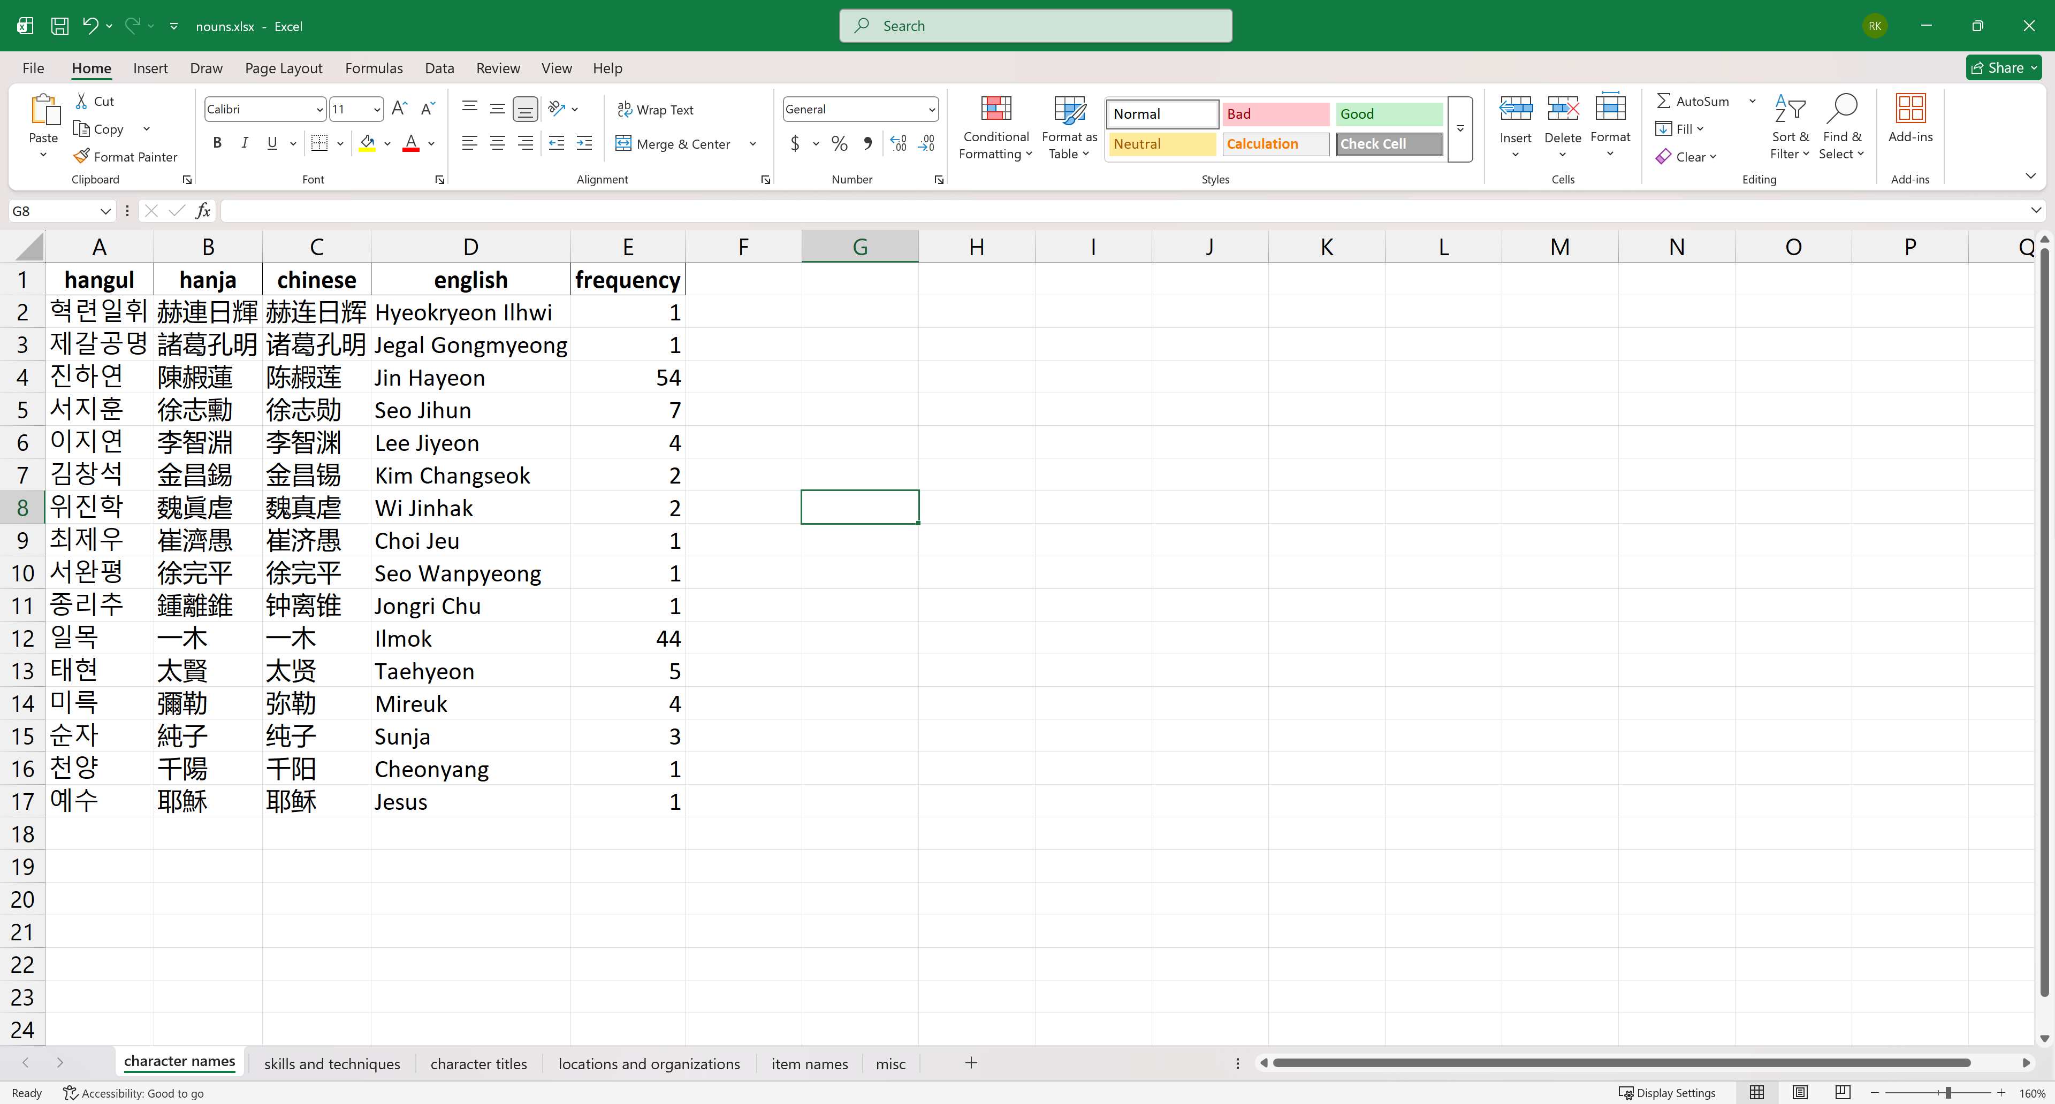
What does glossary maker do?
This tool helps you create a translation glossary spreadsheet for Korean novels, to improve the quality of your machine translations. Here is an example of the output:

Slide 3
Requirements
1) Python: This is a programming language that makes the tool work. You'll need to install it from the official website (https://www.python.org/downloads/). Make sure to check the 2 boxes that say "Add Python to PATH" and "pip" during installation. This step lets your computer easily find and run the program.
2) Google Cloud Project: Create a google cloud project at https://cloud.google.com. Enable Vertex API at https://console.cloud.google.com/apis/library/aiplatform.googleapis.com. Download and install gcloud from https://cloud.google.com/sdk/docs/install. Open a new terminal and run: gcloud auth application-default login
3) Run "setup.py" by double-clicking it before you proceed to ensure everything is properly set up. You only ever need to run it ONCE. You should see the message "SETUP SUCCESSFUL!" in the command prompt window that pops up.

Slide 4
Instructions
Put your novel chapter Korean raws in .txt file format inside a folder and copy it into the main directory. I have provided a folder named "raws" as an example.
You can name the folder anything you want, but it must not have spaces. E.g. “Absolute_Regression” or “Solo-Leveling” are fine but not “Return of the Blossoming Blade”

Slide 5
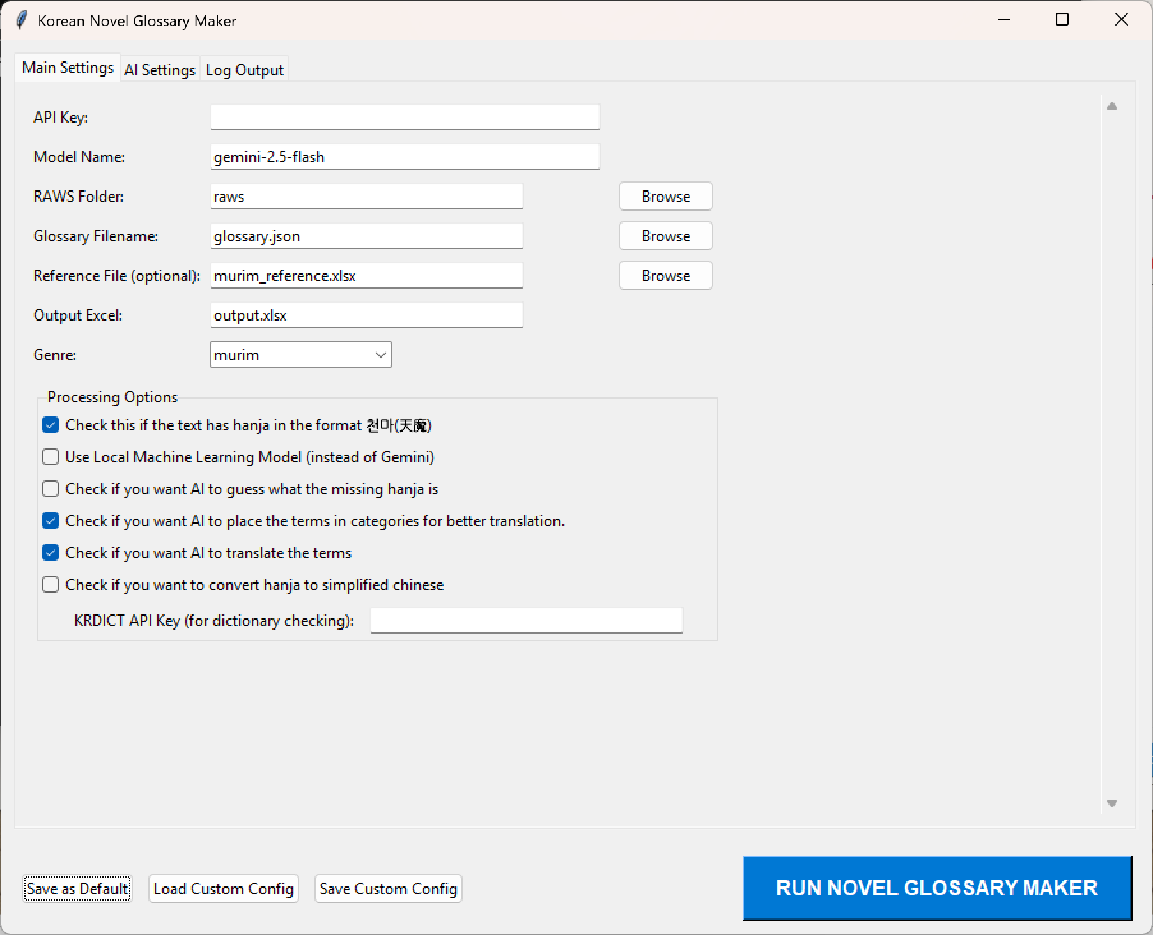
instructions
Start the Program: Find the program file called GLOSSARY_MAKER.py and double click it. You should see the following screen:

Slide 6
Instructions – Main settings tab
Paste the Google API key you got earlier here
Choose your favorite Gemini AI model.
Note not all models are available for free usage.
Type the folder name or browse to the folder where you saved your Korean novel .txt files
This is the base file where all glossary terms are saved. If you are continuing from a previous glossary creation (i.e. same series, new chapters), type or choose the relevant filename here. If not, type a new filename.
If you are making a glossary for a murim novel, leave this as is. If you have made a glossary manually before, you can use your own reference excel spreadsheet, but note that it must follow the same format as murim_reference.xlsx. If the novel does not belong to the murim genre and you don’t have your own glossary yet, delete the text and leave this blank

Slide 7
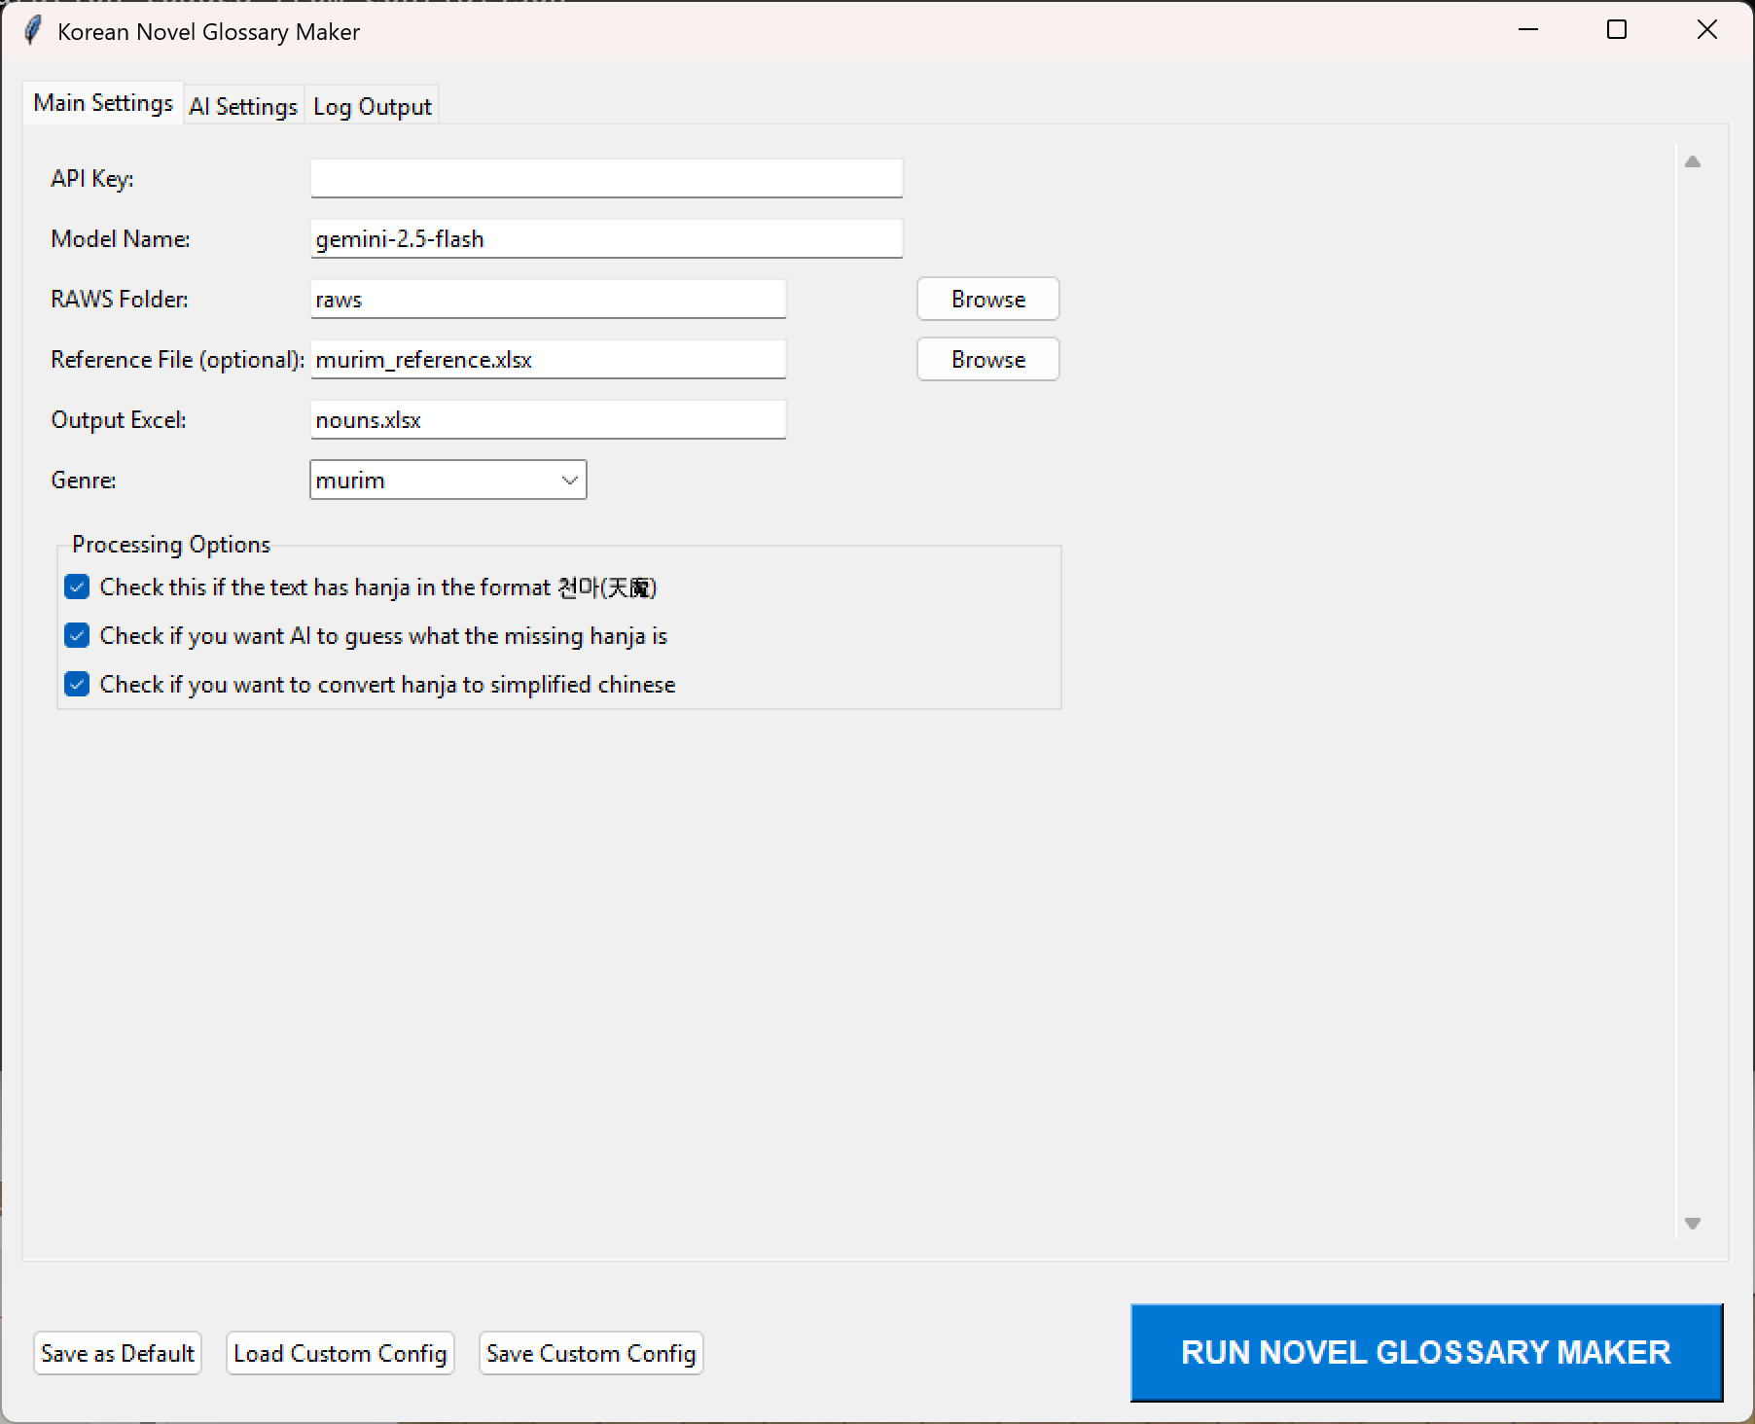
instructions – Main settings tab
Type your desired glossary file name here. Make sure it ends with .xlsx
Select the genre of your novel. We have: murim: Chinese martial arts novel
rofan: romance fantasy novel
modern: modern day novel
game: MMO/VRMMO novel or system novel
westfan: western fantasy novel
dungeon: modern day novel with dungeons or towers

Slide 8
instructions – Main settings tab
Check this only if your novel has hanja in brackets next to hangul
Not all glossary terms identified will have hanja. Check this if you want AI to guess the hanja
Check this if your novel has hanja, you asked AI to guess the hanja, AND you can read Chinese
Click this to save your current settings as default
Click these to save your current settings as a new custom config file, or load a custom config file that you saved previously

Slide 9
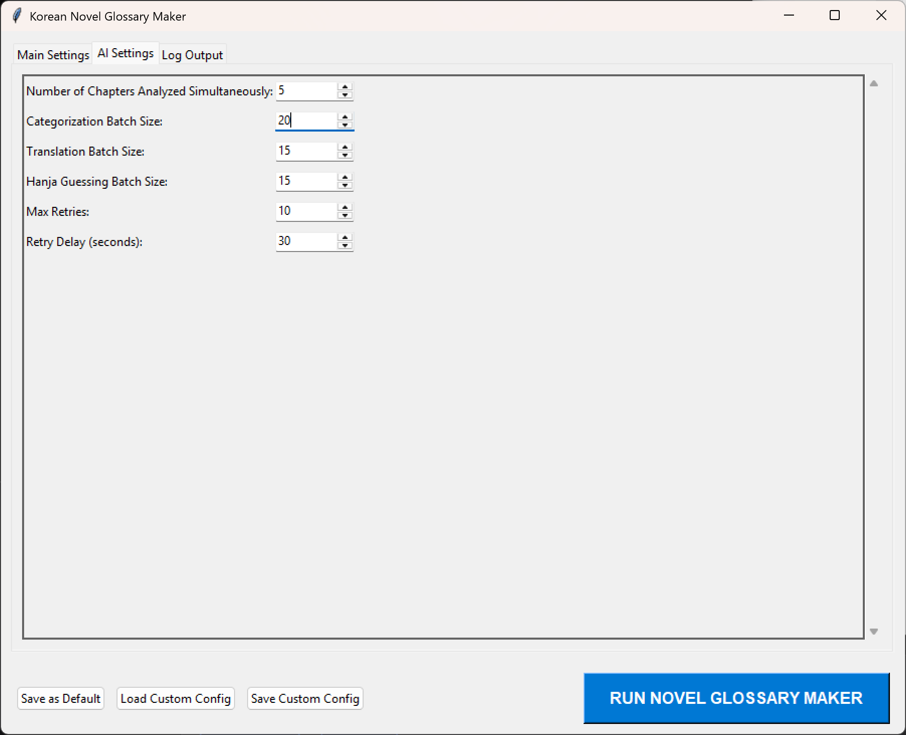
Instructions – AI settings tab
Increase these numbers if you wish to use fewer AI credits and save money
Decrease these numbers if you keep seeing the MAX_TOKEN error in the output, or your output file looks strangely truncated
Number of Chapters Analyzed Simultaneously: How many novel chapters are analyzed at the same time. Decrease this if the novel chapters are long.
Categorization Batch Size: How many nouns are put into categories (names, locations, items) at the same time
Translation Batch Size: How many nouns are translated at the same time
Hanja Guessing Batch Size: How many nouns are submitted for hanja guessing at the same time (if enabled)
How many times to retry when you run into an AI error
If you are on a billing account (i.e. paying money for the gemini api), you can decrease this to 1 second. If you are on a free account, leave as is.

Slide 10
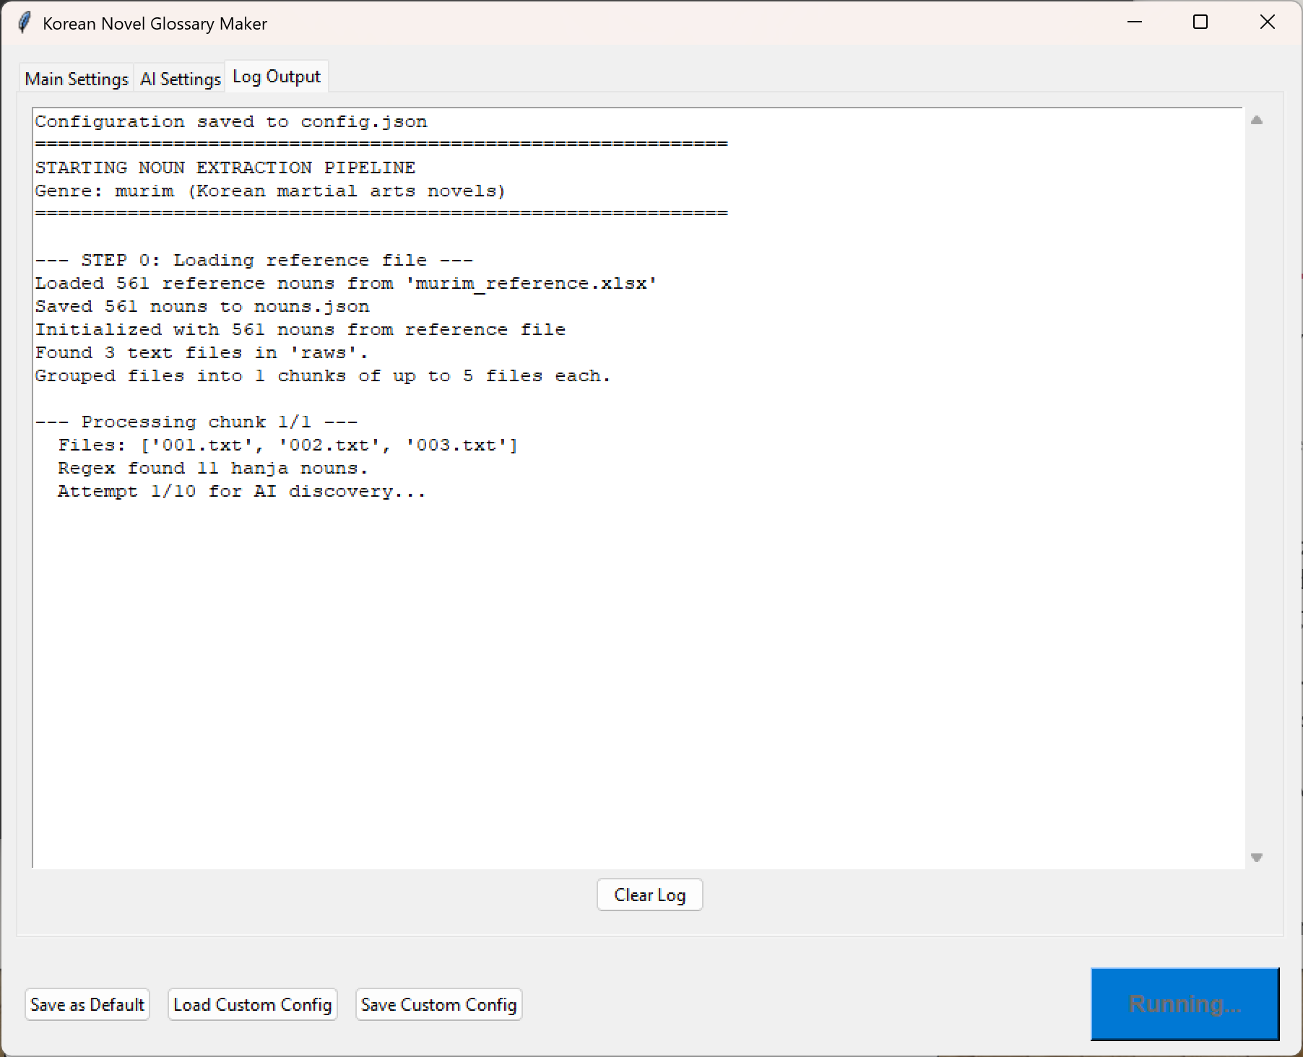
Instructions – Log Output tab
Observe your glossary making progress
Watch out for errors

Slide 11
PIPELINE COMPLETED SUCCESSFULLY!
You should see a file named nouns.json in the folder. If you wish to continue adding nouns to the same novel (e.g. you made a glossary for chapters 1-10, and now you’re updating it for chapters 11-20), this file will be necessary.
nouns.json will be overwritten whenever you run the code, so if you are working on multiple novels, remember to BACKUP this file.
You should also see two new excel spreadsheets. One of them has the terms in different categories in separate worksheets for easier visualization, while the other has every term on ONE worksheet for easier MTL-ing.
You probably want to check the generated glossary spreadsheets manually and change any mis-translated terms and names. AI is stupid, it happens.

Slide 12
Happy MTL-ing!
Credits: foodiemonster007

